Slide 1
Voting Models in Random Networks
Yildiz, M.E. et al. “Voting models in random networks.” Information Theory and Applications Workshop (ITA), 2010. 2010. 1-7. ©2010 Institute of Electrical and Electronics Engineers
Presented by Vedang Joshi

Slide 2
Introduction & motivation
Networks of interacting agents are a key tool to model social phenomena.
Fundamental applications to business and marketing decision making processes.
Pioneered by the work by Watts and Strogatz [1] which shows common features in neural networks in worms, power grid networks and film actor networks.
Uses in analysing the diffusion of innovations in social networks.
Can local interaction between neighboring agents convince the population to conform to single opinions?
How fast is the process of convincing the entire population?
Depends on the method of agent interactions.
[1] Watts, Duncan J., and Steven H. Strogatz. "Collective dynamics of ‘small-world’networks." Nature 393.6684 (1998): 440-442.

Slide 3
Proposed algorithm for opinion convergence
Voter algorithm
Node in the network adopts the same behaviour as one of its randomly chosen neighbours.
Original algorithm proposed in [2] but assumed that there are only two possible behaviours to adopt.
Original contribution by authors: Do not make this assumption and allow all nodes to have different opinions initially.
Author assumptions:
Finite number of nodes in the network
The graph under consideration is strongly connected i.e. there is always a path between any 2 nodes.
[2] Liggett, Thomas M. “The Voter Model”. Interacting Particle Systems. Springer, Berlin, Heidelberg, (2005). 264-314.

Slide 4
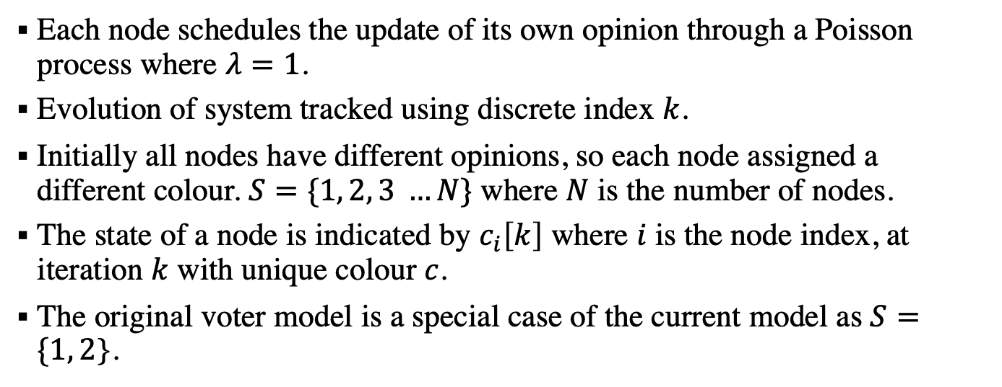
General voter model setup
Each node schedules the update of its own opinion through a Poisson process where $λ=1$.
Evolution of system tracked using discrete index $k$.
Initially all nodes have different opinions, so each node assigned a different colour. $S=\{1, 2, 3 …N\}$ where $N$ is the number of nodes.
The state of a node is indicated by $c_{i}\left[k\right]$ where $i$ is the node index, at iteration $k$ with unique colour $c$.
The original voter model is a special case of the current model as $S=\{1, 2$}.

Slide 5
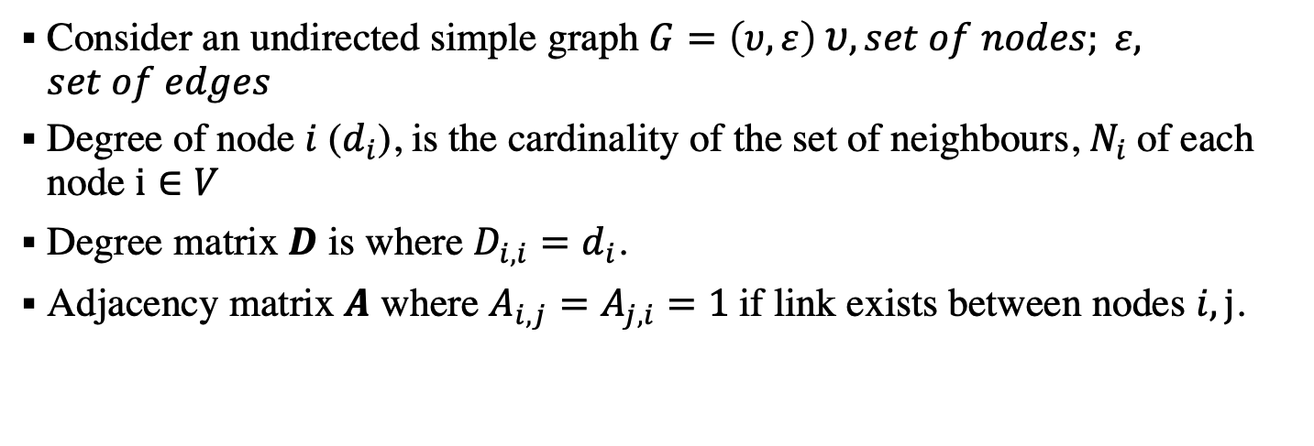
Graph theory terminology
Consider an undirected simple graph $G=\left(υ,ε\right) υ, set of nodes; ε, set of edges$
Degree of node $i$ ($d_{i}$), is the cardinality of the set of neighbours, $N_{i}$of each node $i∈V$
Degree matrix $D$ is where $D_{i,i}=d_{i}$.
Adjacency matrix $A$ where $A_{i,j}=A_{j,i}=1$if link exists between nodes $i,j$.

Slide 6
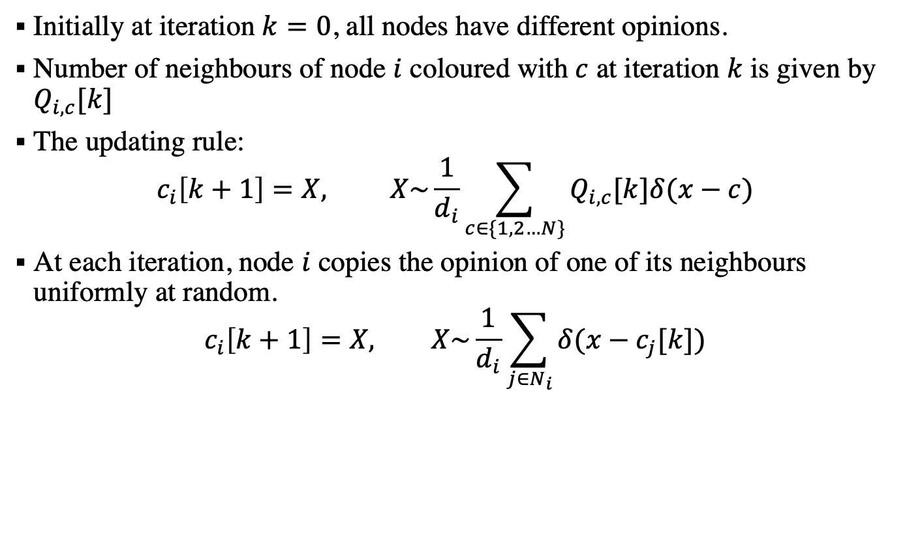
Reaching agreement
Initially at iteration $k=0$, all nodes have different opinions.
Number of neighbours of node $i$ coloured with $c$ at iteration $k$ is given by $Q_{i,c}[k]$
The updating rule:
$$c_{i}\left[k+1\right]=X, X\sim \frac{1}{d_{i}}\sum_{c∈\{1,2…N\}}{Q_{i,c}[k]δ(x−c)}$$
At each iteration, node $i$ copies the opinion of one of its neighbours uniformly at random.
$$c_{i}\left[k+1\right]=X, X\sim \frac{1}{d_{i}}\sum_{j∈N_{i}}{δ(x−c_{j}[k])}$$

Slide 7
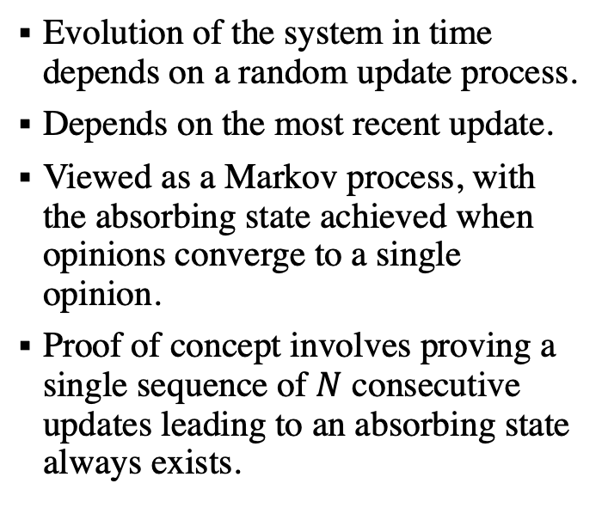
Convergence properties
Evolution of the system in time depends on a random update process.
Depends on the most recent update.
Viewed as a Markov process, with the absorbing state achieved when opinions converge to a single opinion.
Proof of concept involves proving a single sequence of $N$ consecutive updates leading to an absorbing state always exists.

Slide 8
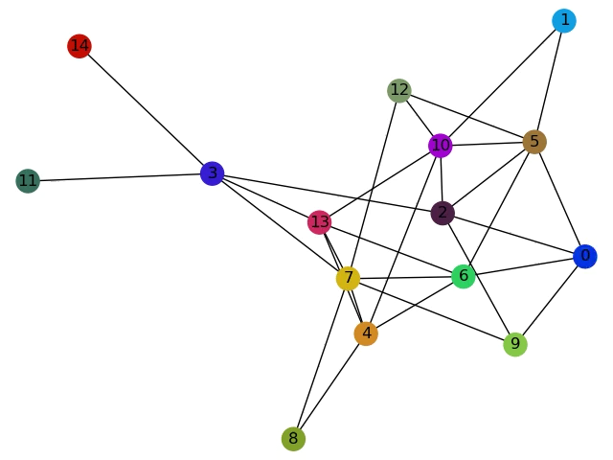
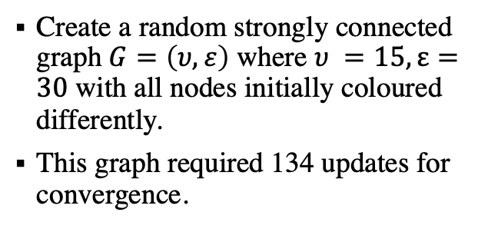
Simulating the voter algorithm on a random graph
Create a random strongly connected graph$G=\left(υ,ε\right)$ where $υ =15, ε=30$ with all nodes initially coloured differently.
This graph required 134 updates for convergence.

Slide 9
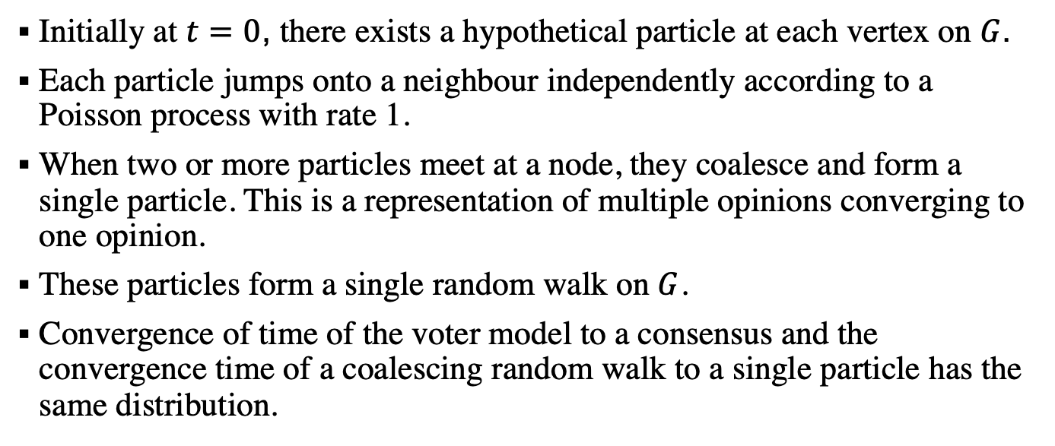
Coalescing random walks
Initially at $t=0$, there exists a hypothetical particle at each vertex on $G$.
Each particle jumps onto a neighbour independently according to a Poisson process with rate 1.
When two or more particles meet at a node, they coalesce and form a single particle. This is a representation of multiple opinions converging to one opinion.
These particles form a single random walk on $G$.
Convergence of time of the voter model to a consensus and the convergence time of a coalescing random walk to a single particle has the same distribution.

Slide 10
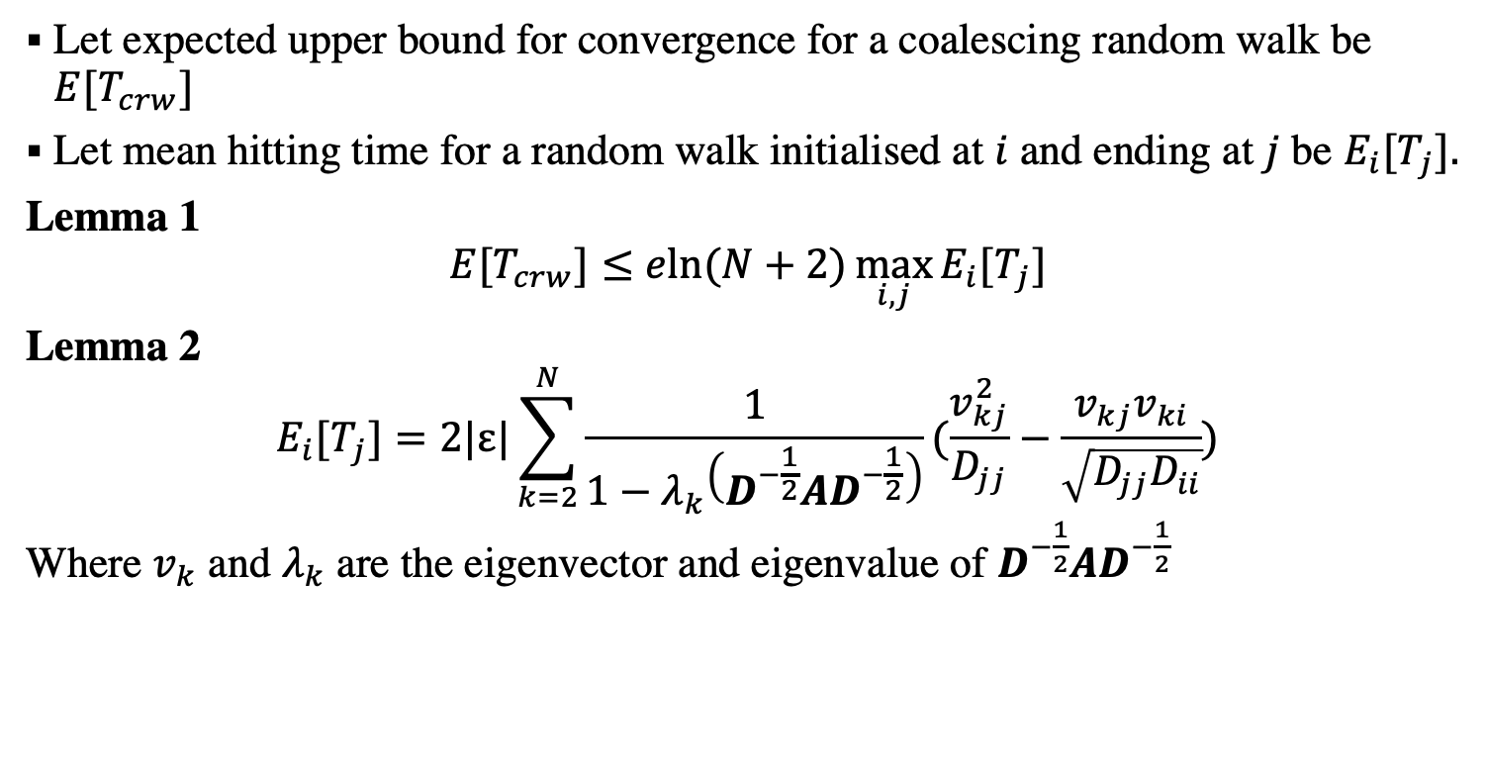
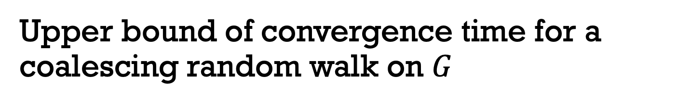
Upper bound of convergence time for a coalescing random walk on $G$
Let expected upper bound for convergence for a coalescing random walk be ${E[T}_{crw}]$
Let mean hitting time for a random walk initialised at $i$ and ending at $j$ be ${E_{i}[T}_{j}].$
Lemma 1
$${E[T}_{crw}]≤eln⁡(N+2)\max_{i,j}{{E_{i}[T}_{j}]}$$
Lemma 2
$${E_{i}[T}_{j}]=2|ε|\sum_{k=2}^{N}{\frac{1}{1−λ_{k}\left(D^{−\frac{1}{2}}AD^{−\frac{1}{2}}\right)}(\frac{v_{kj}^{2}}{D_{jj}}−\frac{v_{kj}v_{ki}}{\sqrt{D_{jj}D_{ii}}})}$$
Where $v_{k}$ and $λ_{k}$ are the eigenvector and eigenvalue of $D^{−\frac{1}{2}}AD^{−\frac{1}{2}}$

Slide 11
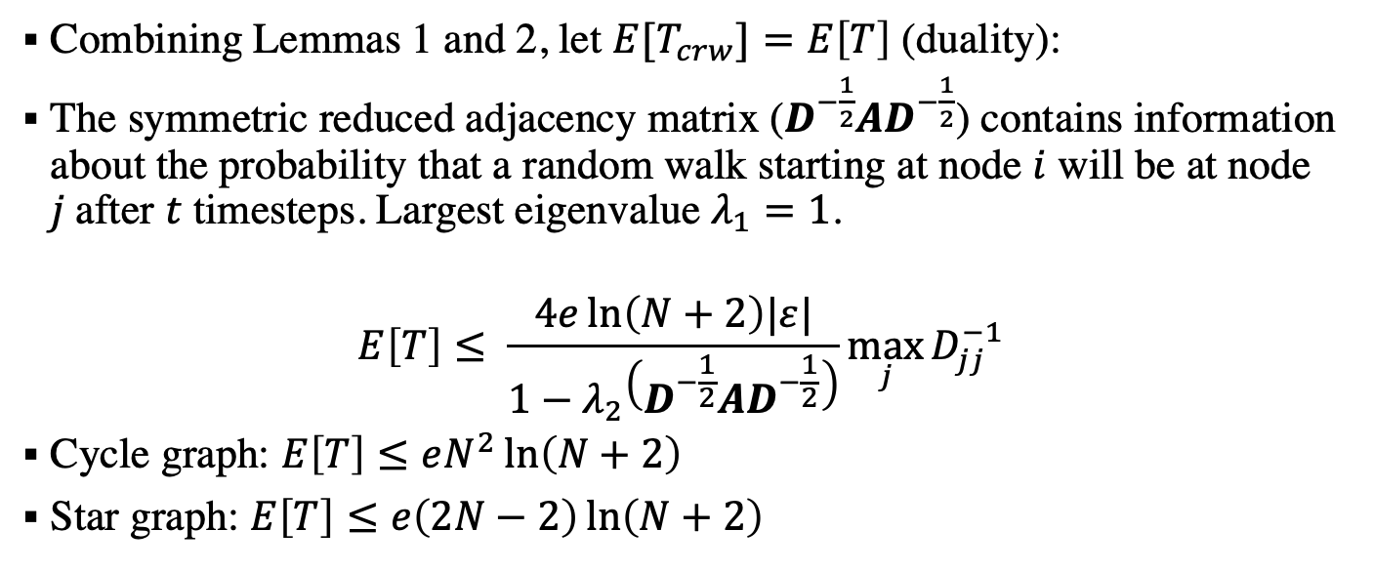
Main result
Combining Lemmas 1 and 2, let ${E[T}_{crw}]=E\left[T\right]$ (duality):
The symmetric reduced adjacency matrix ($D^{−\frac{1}{2}}AD^{−\frac{1}{2}}$) contains information about the probability that a random walk starting at node $i$ will be at node $j$after $t$ timesteps. Largest eigenvalue $λ_{1}=1$.
$$E\left[T\right]≤ \frac{4e\ln\left(N+2\right)|ε|}{1−λ_{2}\left(D^{−\frac{1}{2}}AD^{−\frac{1}{2}}\right)}\max_{j}{D_{jj}^{−1}}$$
Cycle graph: $E\left[T\right]≤eN^{2}\ln\left(N+2\right)$
Star graph: $E\left[T\right]≤e\left(2N−2\right)\ln\left(N+2\right)$

Slide 14
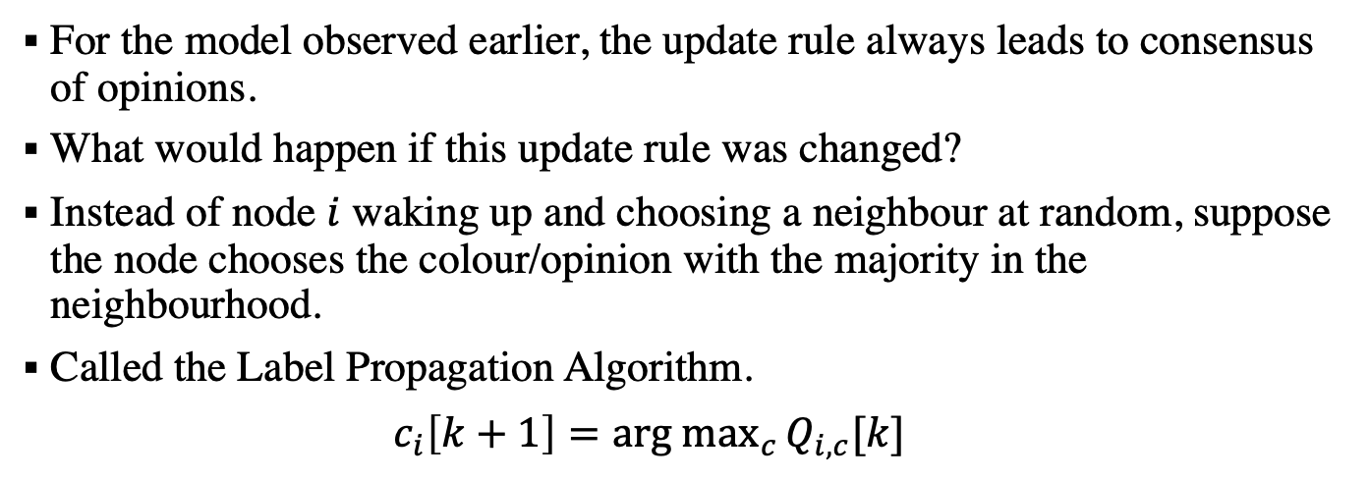
Disagreement on a network
For the model observed earlier, the update rule always leads to consensus of opinions.
What would happen if this update rule was changed?
Instead of node $i$ waking up and choosing a neighbour at random, suppose the node chooses the colour/opinion with the majority in the neighbourhood.
Called the Label Propagation Algorithm.
${ c}_{i}\left[k+1\right]=\underset{c}{arg max}{Q_{i,c}[k] }$

Slide 15
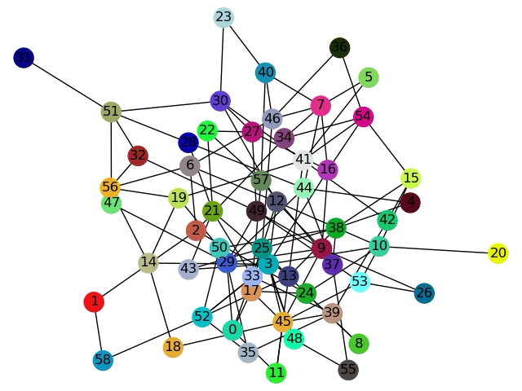

Slide 16

https://github.com/vedang-joshi/ComplexNetworks

